Slide 1
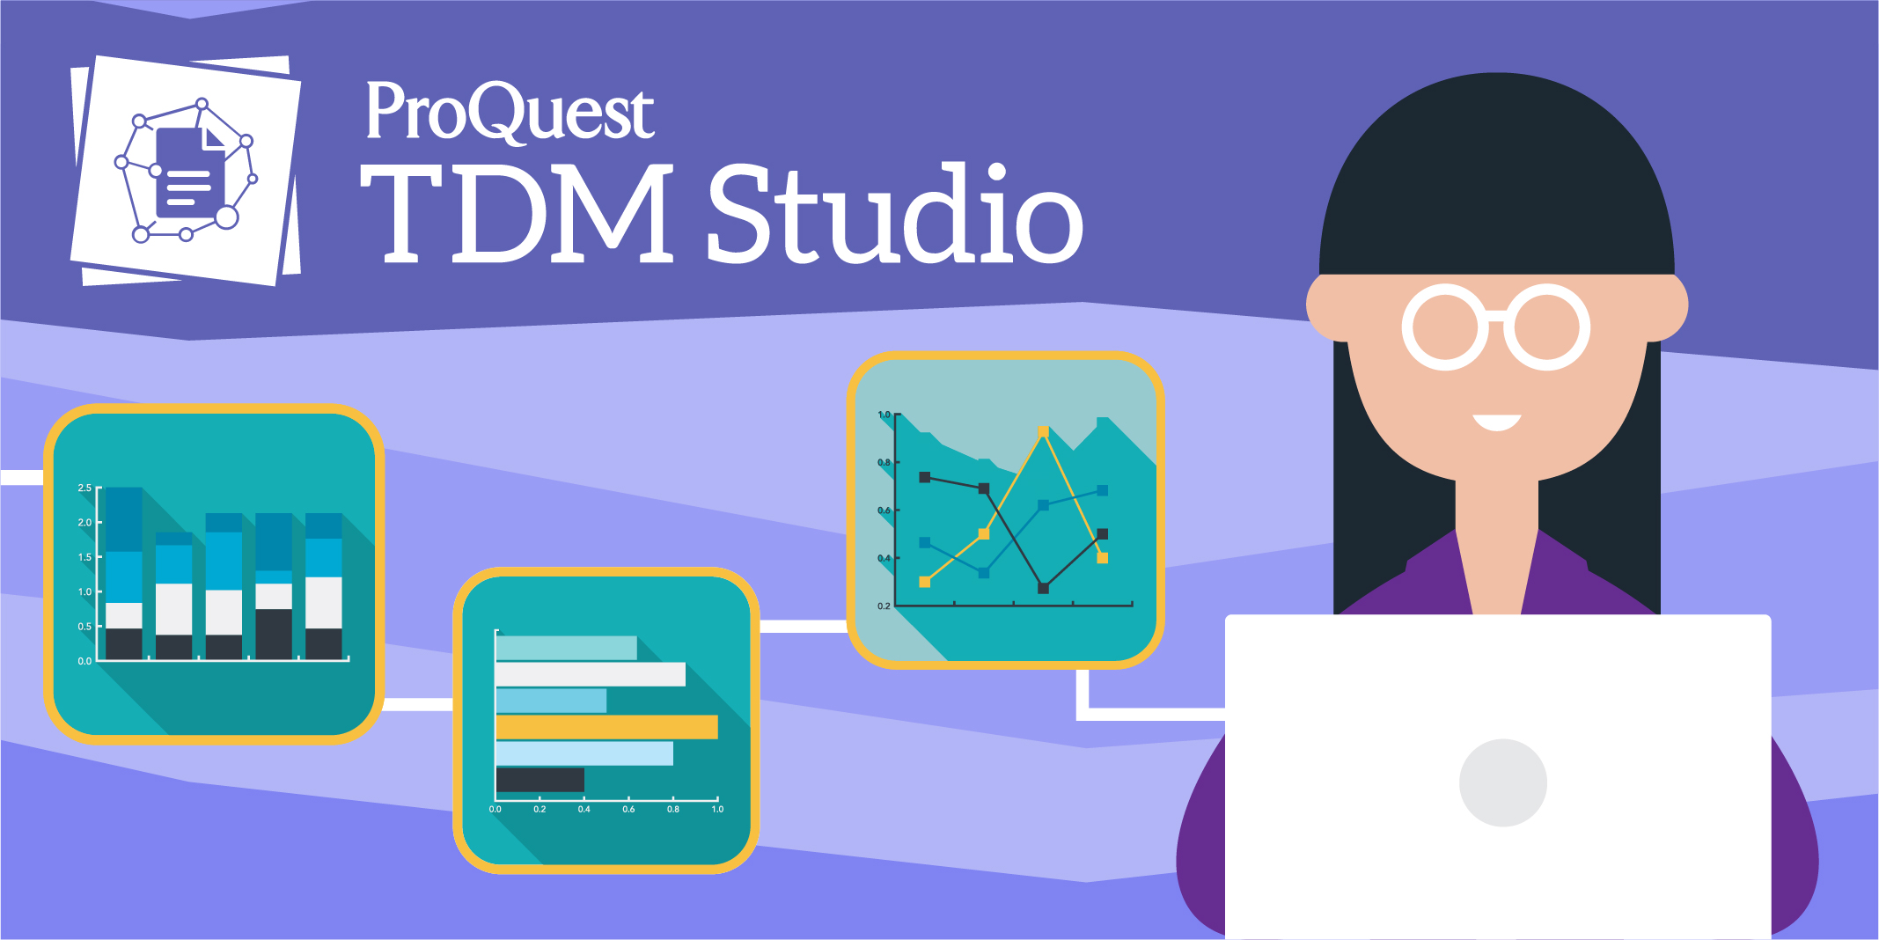
Python or R coding ability?
Use the Workbench.
No coding ability?
Use the Visualizations.
Create an account: tdmstudio.proquest.com/createaccount

